Slide 1
Welcome to CS61A!
Discussion 0
go.cs61a.org/jordan-disc
Groups!
We will be working collaboratively!
We will start at Berkeleytime at 7:10! In the meantime, please fill out the poll for fun!
Jordan Schwartz (She/They)
Tuesday, 6/21/22
7:00-8:30pm PST

Slide 2
Friendly reminder:
Please ask me questions today :))

Slide 3

Agenda
Intro
Logistics
Website walkthrough
Group Activity
Survey
Advice
Please ask me questions today!! Raise your hand! Or use the chat!
Questions are vital to learning

Slide 4
Intro & Logistics

Slide 5
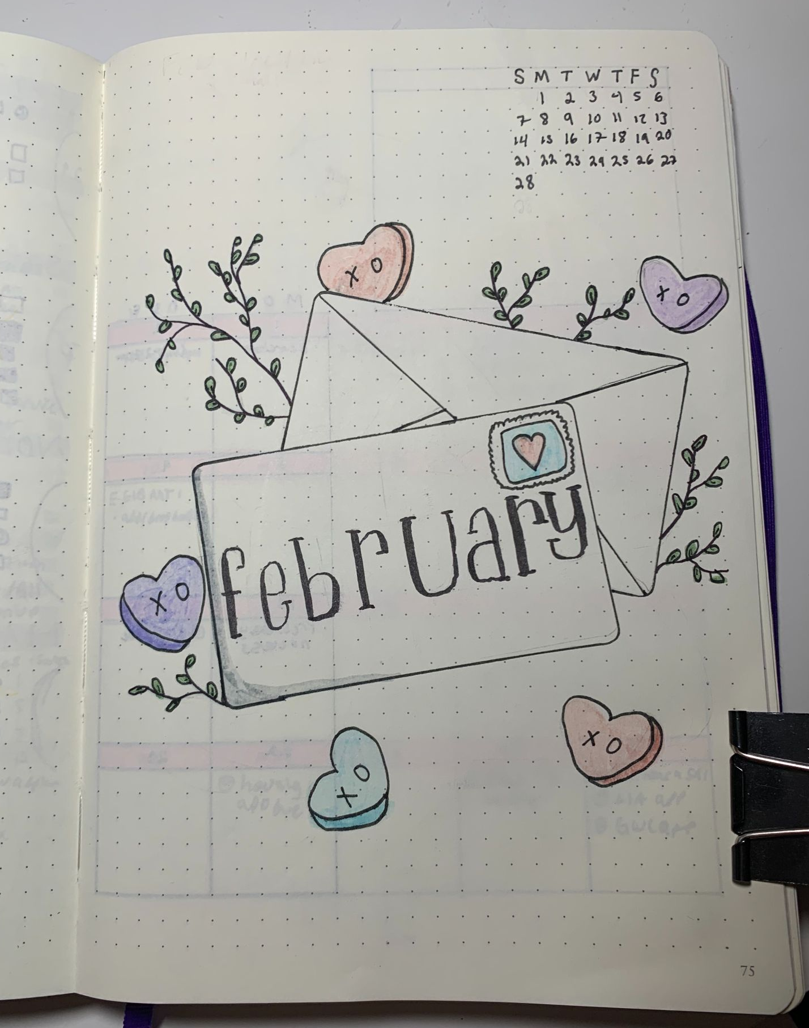
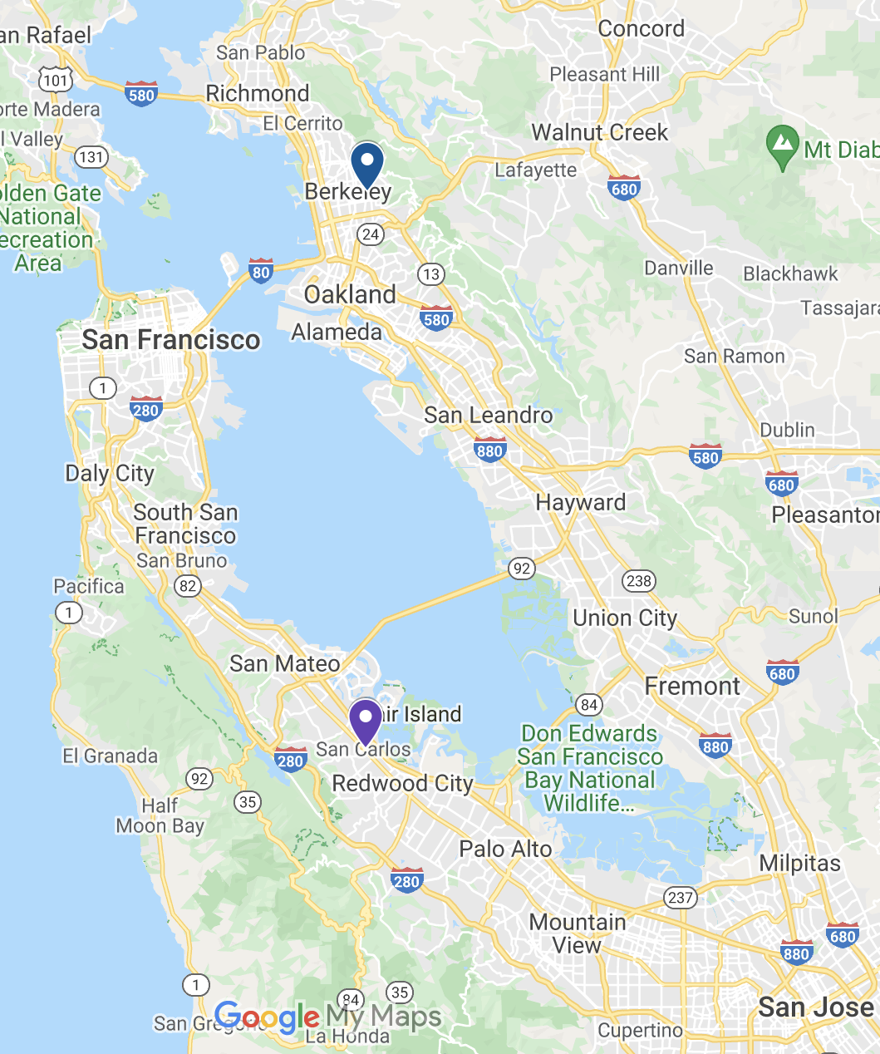
About Me
Rising Junior, CS and CogSci major
Sixth semester teaching → CS10 AI, 61A AI, 61A TA, CSM CS88 mentor, CSM 61A SM and Coord
Outside of classes:
cooking/baking
crochet
general crafting
vinyl records, 70s-80s music
Swing dance! (Lindy on Sproul)
San Carlos, CA -- Berkeley, CA
jordanschwartz@berkeley.edu
Email me with any questions related to course or not!
Looking forward to meeting you all!
Open inbox policy -- will try to respond within 24 hours
My OH: Advising style– book here

Slide 6
Why Discussion? Why like this?
Reinforce conceptual understanding, develop problem solving skills in a collaborative environment
Discussions → group collaboration → different perspectives → deeper development of concepts → better learning → better experience in 61A!
Bonus: Your engagement helps my engagement which makes me a better teacher for you!
Discussion is not:
Regurgitating lecture content
Giving you answers to problems
Testing you for mastery or singling you out in front of a group

Slide 7
Each Section, You Should Expect:
Checkin/poll
Short review of relevant material
Worksheet with problems on said material
Group work emphasis
Will most likely never get through the whole thing (on purpose)
Interaction and collaboration
In remote sections, my camera will be on, if possible please keep yours on too
Please unmute/communicate in breakout rooms
Attendance form

Slide 8
Each Section, We Should Expect from each other:
Respect
Be cool
Don’t dominate discussion by giving all the answers
Goal: make sure everyone you work with understands the material well enough that they can explain it too
Don’t be disruptive or hurtful
Contributing by raising hands is good (chat is okay too!)
Fill out forms! Get attendance!
Anything you want to add?

Slide 9
Absences
For the week because of a time conflict:
Go to another section that week, email the TA ahead of time!
For the week because you are sick/can’t make it to any sections:
Attend the remote section! (the zoom link is available at sections.cs61a.org
Email me, we can work something out :)) – discussion is not meant to make your life more stressful
Need an extension? Accommodations?
Discussion and lab materials will always all be available online
https://go.cs61a.org/jordan-disc
https://go.cs61a.org/jordan-lab (does not exist yet lol)
https://go.cs61a.org/jordan-notes (also does not exist yet lol, but will have handwritten notes)

Slide 10
Course Website Walkthrough and Link to Discussion
https://cs61a.org/
https://cs61a.org/disc/disc00/

Slide 11
So much info….
Questions?
Yes, sometimes it will feel like I will wait an awkward amount of time, but sometimes that’s how long it takes to think of a question
(Please ask questions even if we’ve moved on)
Digest...

Slide 12
Lost on the Moon

Slide 13
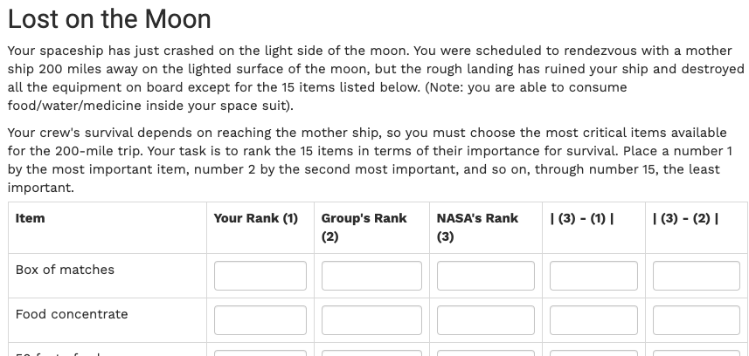

Slide 14
In groups of 3-4…
If you finish early:
Play 2 truths a lie:
Each person says three “facts” about themselves
2 are true, 1 is a lie
Other people try to guess which “fact” is the lie
E.g. 1. I’m vegetarian, 2. I love boba, 3. I have a tattoo of a frog
Debate: is a hot dog a sandwich? Is pizza a sandwich? Is cereal a soup?
(subway bread has so much sugar in it, it is classified as cake in the UK, therefore, sandwiches are really cake)
Name
Pronouns (if you’re comfortable sharing)
Intended major/interest
What was the last meal/food you ate and how was it on a scale of 1-5 (1 being the worst, 5 being the best)
Then come up with a ranking together
Person who ate most recently should start :))

Slide 15
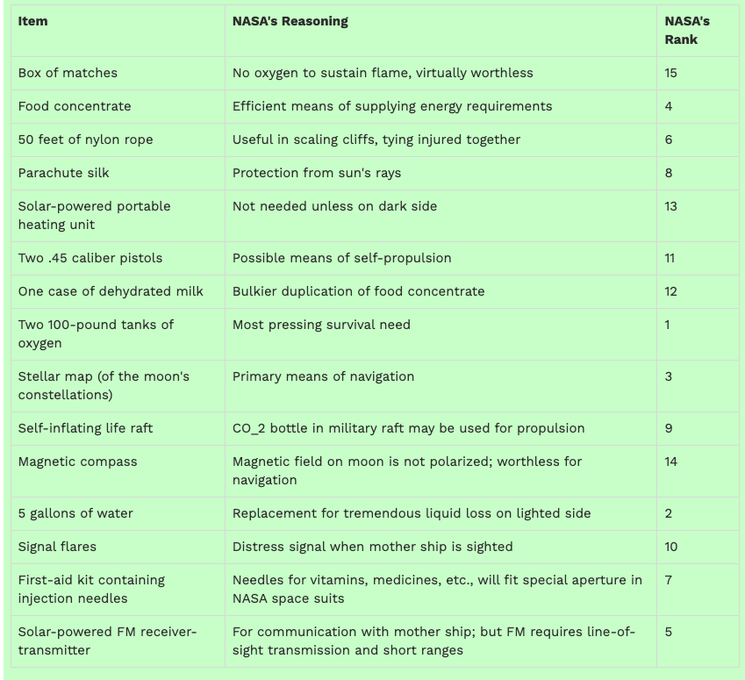
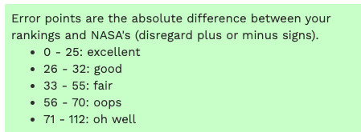
Write down Nasa’s
Fill out the next two columns
Nasa minus individual
Nasa minus group
How did you do?
How did your group do?

Slide 16
The point?
Working as a group will often lead to better results than working alone
Talking it through with a group allowed you to consider some possibilities you didn’t consider on your own

Slide 17
Fill out this form! It’s for your attendance and for me to get to know you! - 10 mins
go.cs61a.org/jordan-attendance
Word of the week:

Slide 18
Which leads us to some good points about 61A...
Collaboration (when allowed) is key
Even just talking out loud to yourself can help you see a new perspective. Crucial when coding
Ask questions!!
OH right before deadlines gets really crowded, but whenever you can come ask questions! Ask questions here! Ask teammates questions!
Try your best!
Breathe, have fun!
Grades are not everything. You are not your grades.
This is a challenging course, you are succeeding just by doing what you can. I believe in you! :)

Slide 19
Please now ask me at least 3 questions!
More would be great
They can be about anything, but preferably 61A!
Questions are good, even (especially) “stupid” ones
I’d love more than 3
I’ve budgeted time for as many as possible
This is roughly 1 question for every 10 of you here
And there’s a good chance that if 1 of you has a question, 10 other people want to ask it too

